Slide 1

Flip robo inc.
Rating prediction projects
By:- Vivek kumar Singh

Slide 2

Agenda
INTRODUCTION
PROBLEM STATEMENT
VISUALIZATION
PRE-PROCESSING
MODELS
CONCLUSION

Slide 3

INTRODUCTION
HOW WE DID LAST YEAR
We have a client who has a website where people write different reviews for technical products.
Now they are adding a new feature to their website i.e.
The reviewer will have to add stars(rating) as well with the review. The rating is out 5 stars and it only has 5 options available 1 star, 2 stars, 3 stars, 4 stars, 5 stars.
e review.

Slide 4

Problem statement
Client want to predict ratings for the reviews which were written in the past and they don’t have a rating.
So, we have to build an application which can predict the rating by seeing the review.

Slide 5
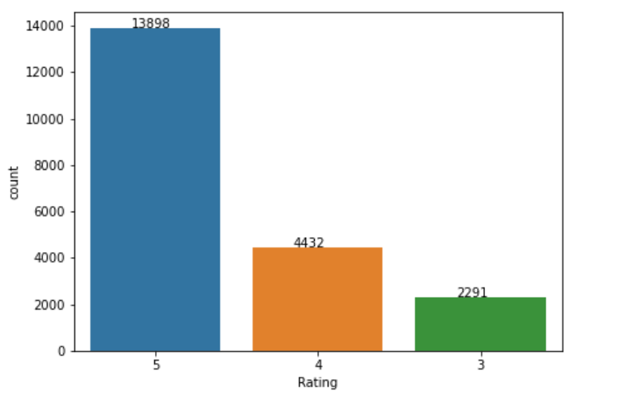
Visualization
5 star- 13898
4 star-4432
3 star-2291
These are the categories of target variable.

Slide 6
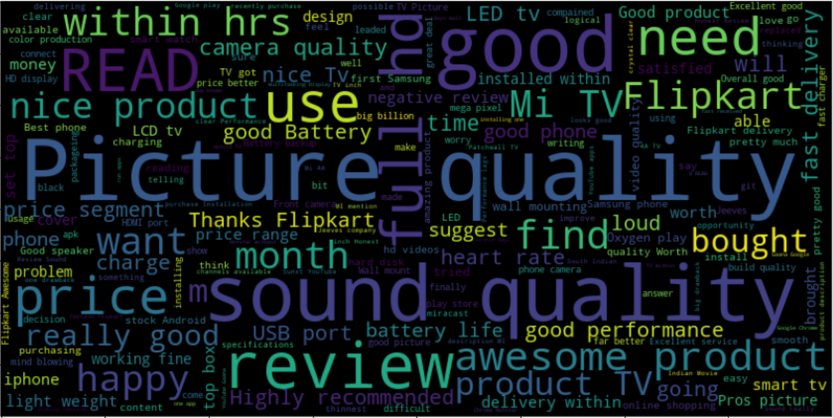
Before cleaning the feature columns here how it looks like. It is review columns which has string/ text data

Slide 7
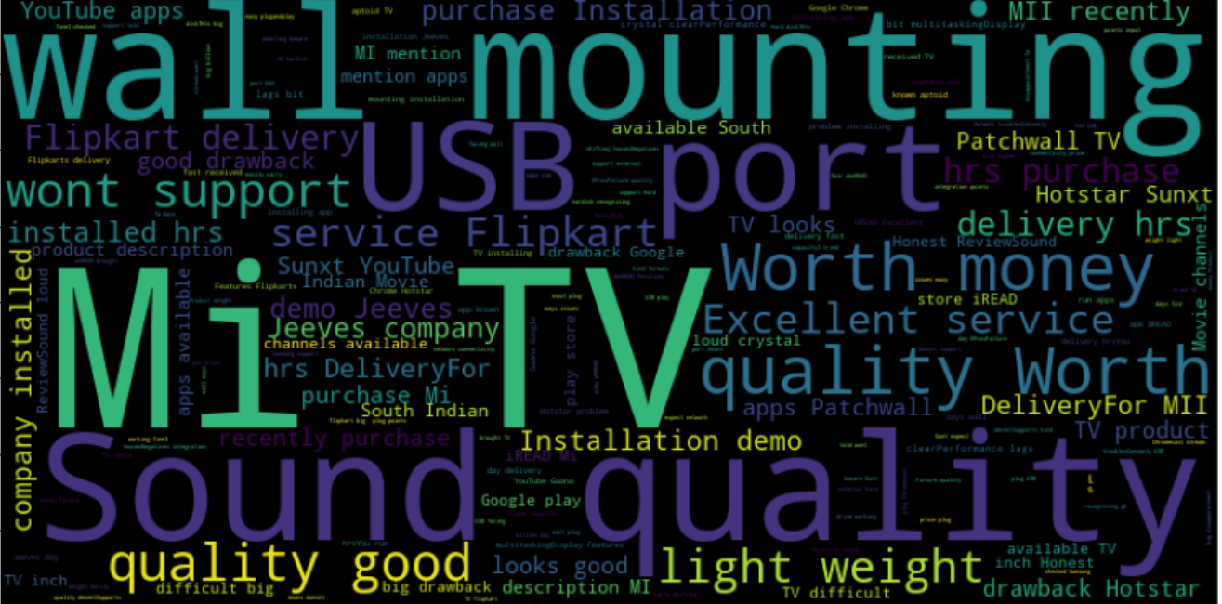
Visualizing the text where, rating==3

Slide 8
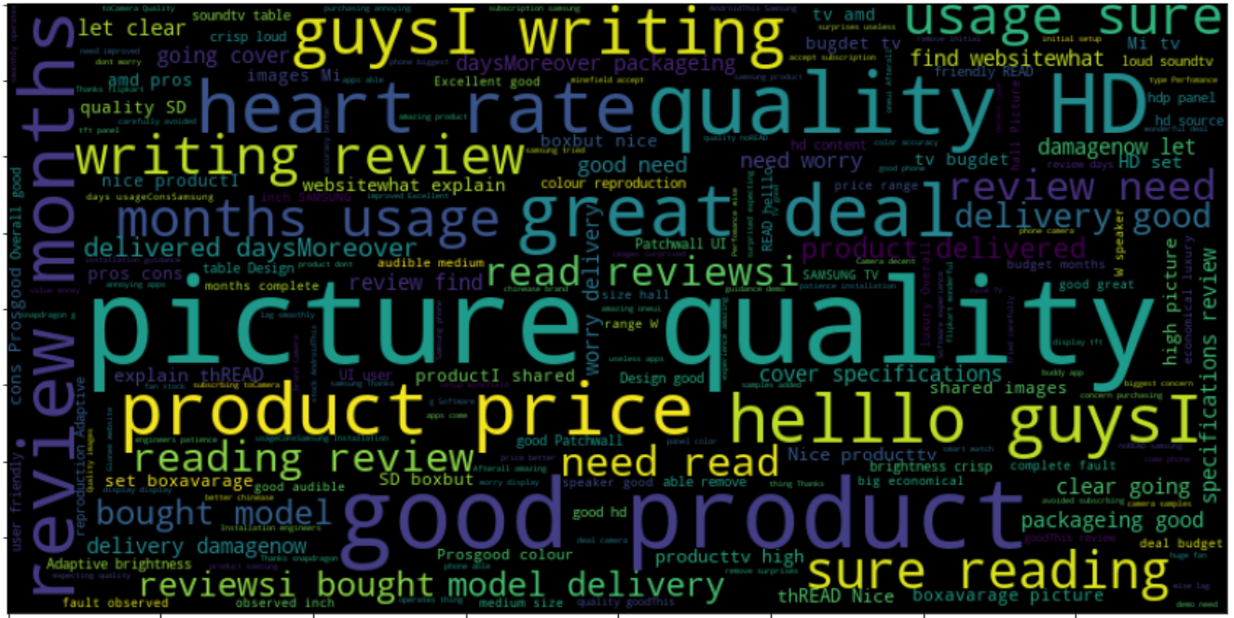
Visualizing the text, where rating ==4

Slide 9
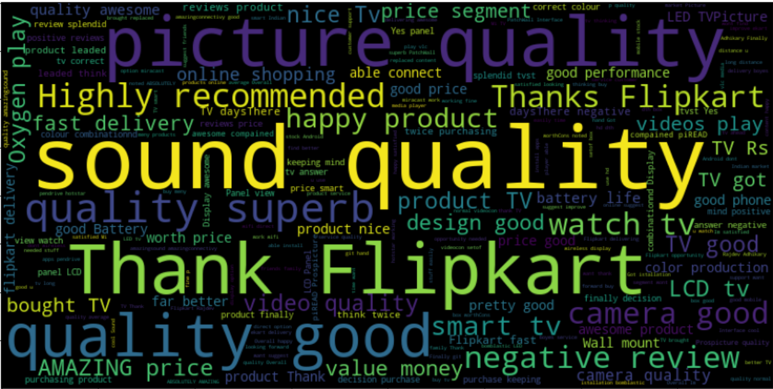
Visualizing the text where, rating==5

Slide 10
Correlation table
 | Rating | Before cleaning | After cleaning
Rating | 1.000000 | -0.210990 | -0.209456
Before cleaning | 0.210990 | 1.000000 | 0.975291
After cleaning | -0.209456 | 0.975291 | 1.000000

Slide 11
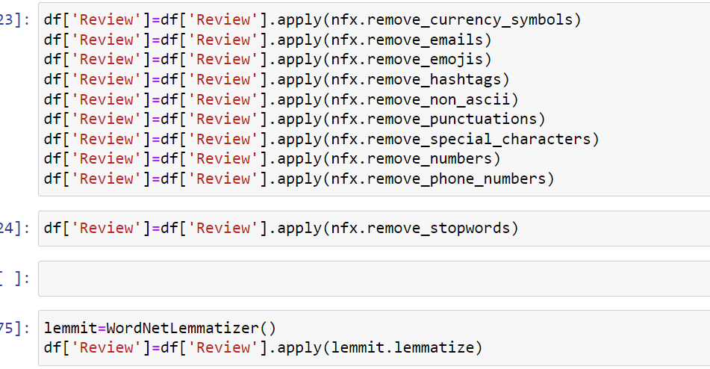
Here,neattext is used for cleaning all type of unwanted text which we find in text review
PRE-PROCESSING

Slide 12
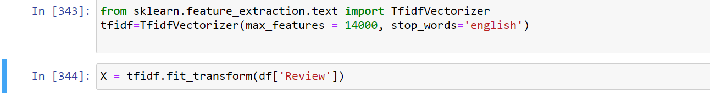
Vectorizer is used to convert string/text data into numeric,so they work on prediction when model is created. Here, tfidf vectorizer is used.
PRE-PROCESSING
VECTORIZER

Slide 13
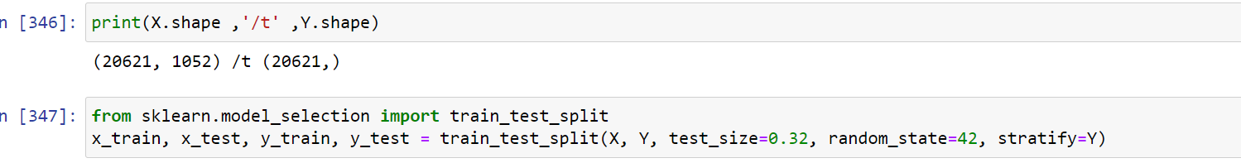
Splitting train and test data for model training and prediction
MODEL TRAINING AND PREDICTION

Slide 14
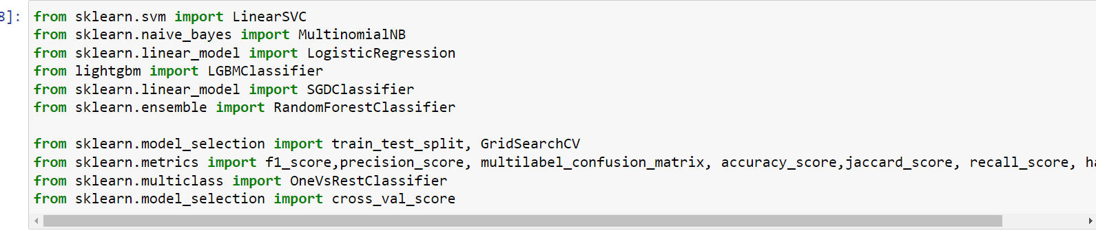
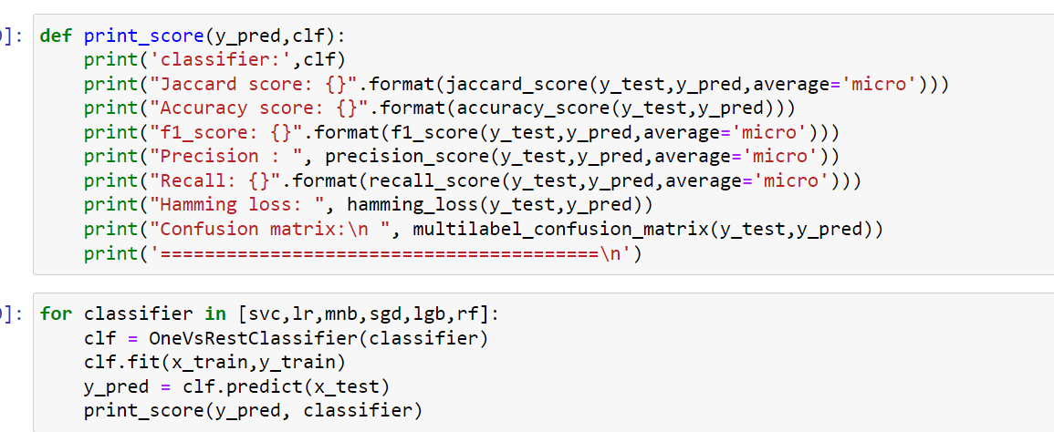
These are the algorithms which is used to train the data and for most effective model shows best results we select that model and save it for prediction
ALGORITHM USED FOR CREATING MODELS

Slide 15
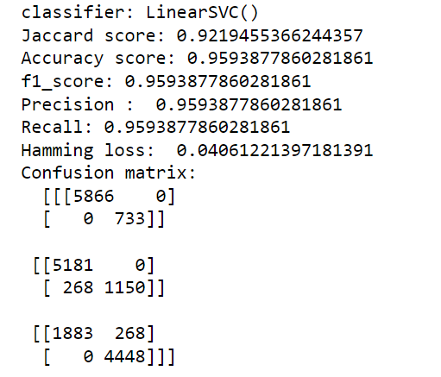
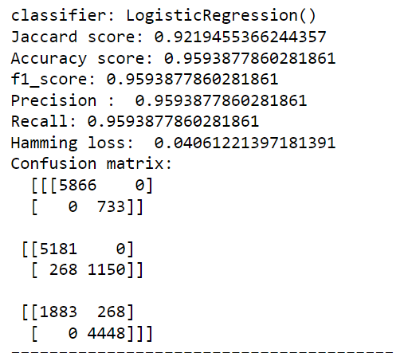
Linear SVC
MODEL SCORES,LOSS, PRECISION, RECALL AND CONFUSION MATRIX
Logistic regression

Slide 16
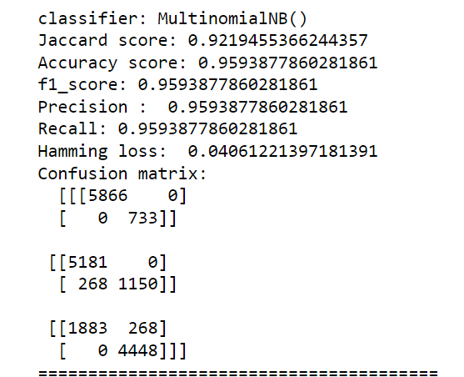
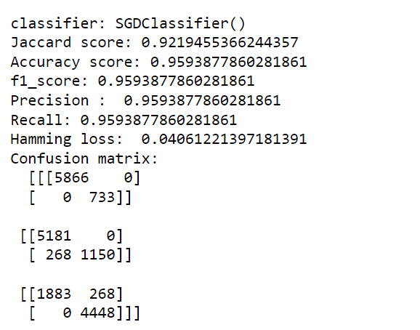
Multinomial NB
Sdg classifier

Slide 17
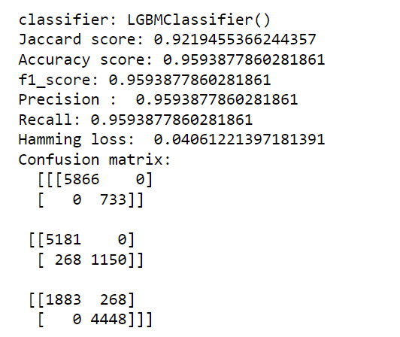
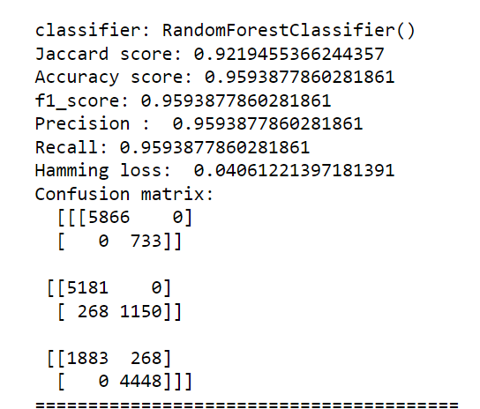
LBGM classifier
Random forest classifier

Slide 18
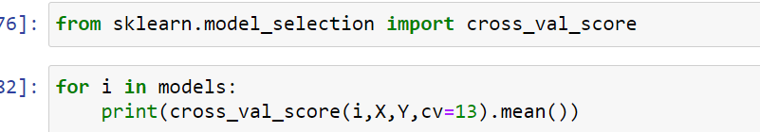
CROSS VALIDATION IS USED FOR ANLYSING THAT IF MODEL IS OVERFITTED OR NOT OR IT MIGHT BE UNDERFITTED
CROSS VALIDATION

Slide 19
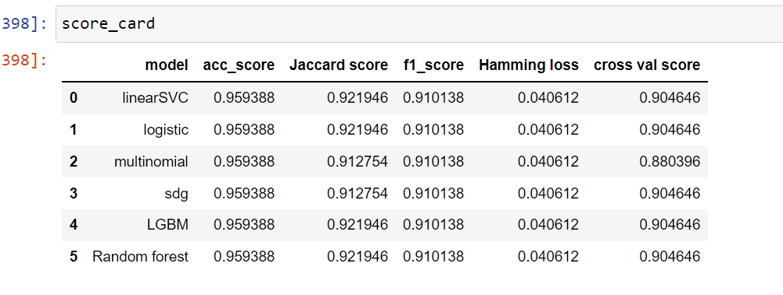
SCORE CARD

Slide 20

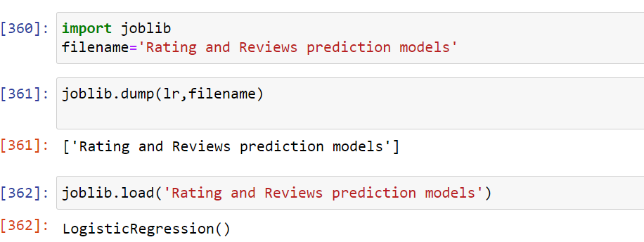
Saving the model
As the all models some of models are showing effective behavior, but her logistic regression model are selected

Slide 21

CONCLUSION
Through this project we are able to learn Various Natural language processing technique such as lemmatization and stemming, removal of stop word
This project has shown us importance of sampling, modelling and prediction of data.
With the help of different types of tool, we use to clean the dataset, cleaning null values. And also vectorized the text data into numeric data.
With the help of tfidf we use vectorizer.
Also, we use here cross validation for analysing the model is overfitted or not.
We made use of natural language processing and create the models. We select and save best model fitted. As per here logistic regression is best selected model.

Slide 22



THANK YOU
Vivek kumar Singh
+91-8340487418
Vivek.singh11030@gmail.com
FLIP ROBO

